Slide 1
Bhuvan Sharma
2019B1A10975P
Mathematical modelling of sea water reverse osmosis

Slide 2

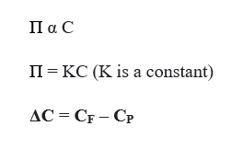
flux is proportional to the Pressure gradient
A_{w} which is the water permeability constant and is the osmotic pressure

Slide 3
The assumptions used to build the model were
Solute and solvent were assumed to dissolve at the membrane and diffuse across it.
Chemical potential difference arising due to the pressure difference is assumed to be negligible.
The gradient for the flux is purely due to the concentration and pressure difference across the membrane.
The solute-solvent diffusion is assumed uncoupled.

Slide 4
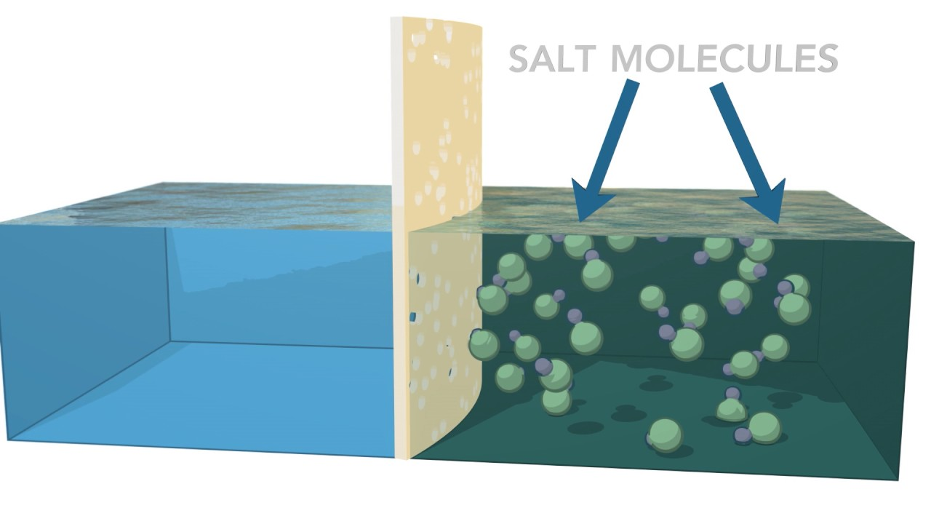
Osmotic Pressure
Phase 1
Phase 2

Slide 5
Virial Equation
Π = a+bC+cC²
Π₁ = a₁+b₁C+c₁C²
Π₂ = a₂+b₂C+c₂C²
Π₁ - Π₂ = (a₁-a₂) + (b₁C_{F} – b₂C_{F}) + (c₁C_{F}² – c₂C_{P}²)
Similarly, we can evaluate P and plug these variables in the above equation
Q_{w} = J_{w} (S_{a})/ ρ_{w}

Slide 6




Pitzer-Debye Huckel Electrolyte Solution Theory

Slide 7



π=
Here k is permeate side concentration of the solute.
K<<0.01M

Slide 8
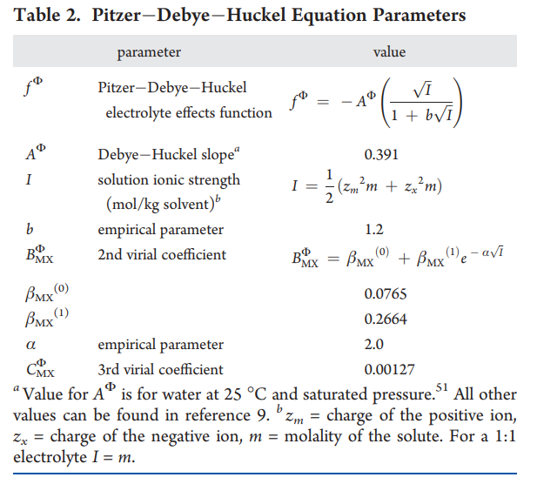

Slide 9
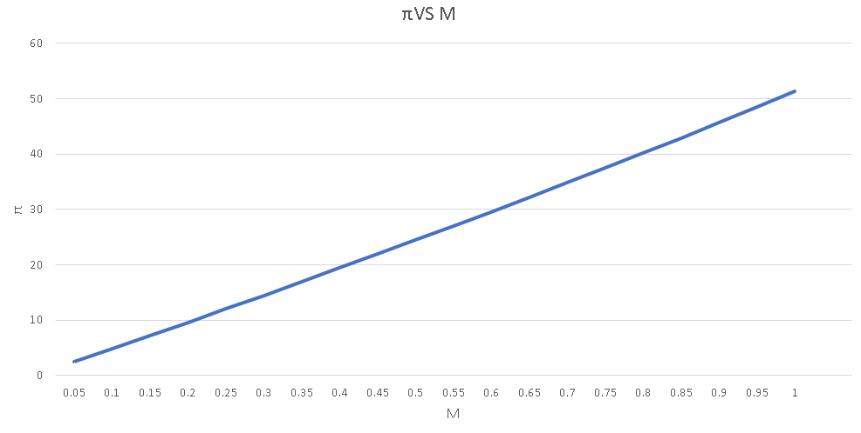
This is a trend obtained between osmotic pressure (π) and solute concentration of the feed.
This trend appears to be linear but it is not.
Here the value of the permeate solute concentration is kept constant, although it will increase with time as the membrane will lose its efficiency.

Slide 10
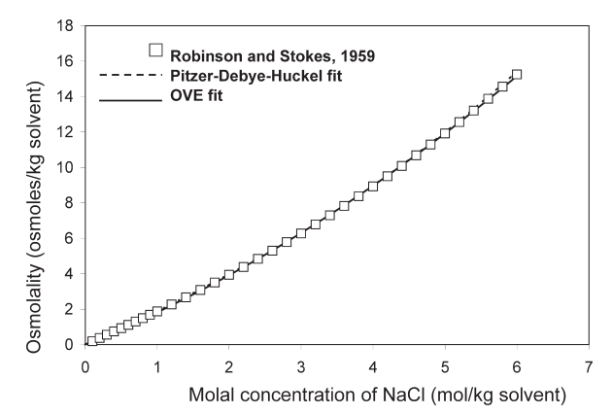

Slide 11

Membrane Rejection
Let us consider that we are using a high pressure RO system.
ΔP = 100 atm, or above.
B_{s} is a function of pressure difference and solute concentration.
Using this equation for the membrane rejection ratio.

Slide 12
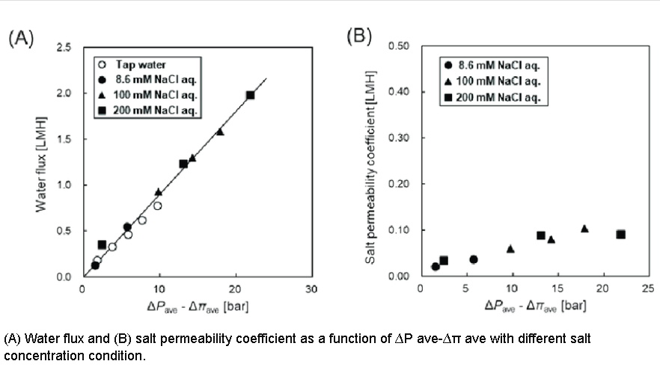
Taking B_{s} as 0.1 for 0.1 M concentration of NaCl.

Slide 13

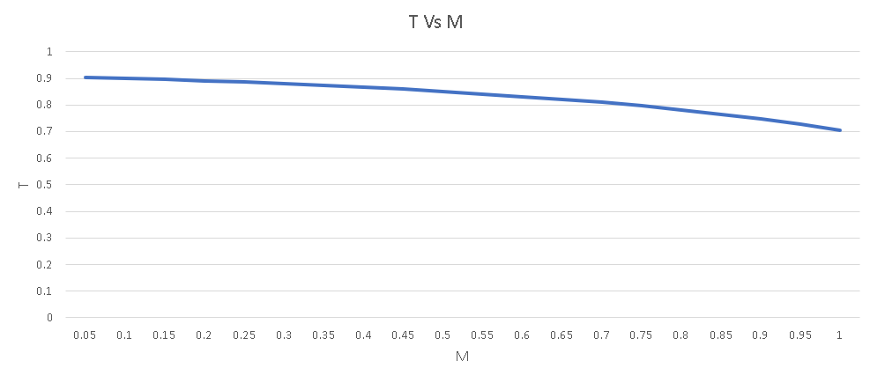
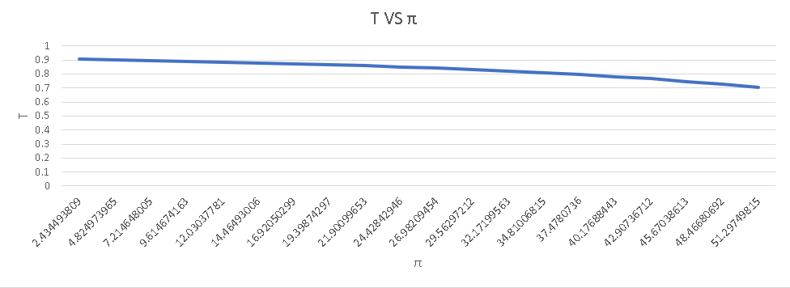

Slide 14
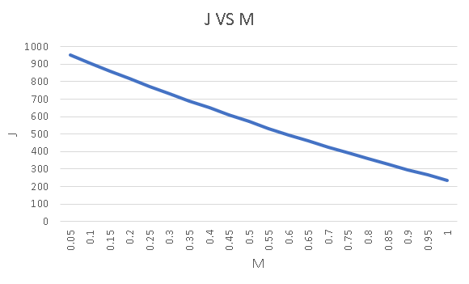
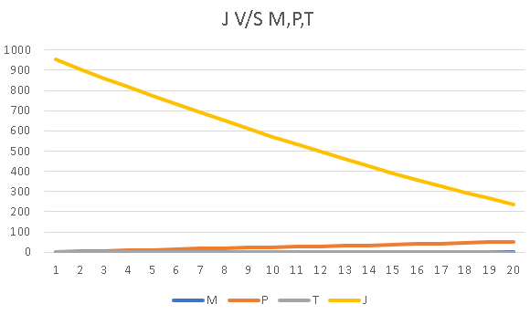
Flux

Slide 15
Conclusion
By introducing Virial equations accuracy in predicting flux and rejection ratio is increased.
Electrolytic interactions of the solutes in the solution are incorporated using virial equations in the calculation of Osmotic pressure.
Assumption of keeping the activity coefficient is relaxed.

